Slide 1
What is Cluster Analysis?
Cluster: a collection of data objects
  Similar to one another within the same cluster
  Dissimilar to the objects in other clusters
Cluster analysis
  Finding similarities between data according to the characteristics found in the data and grouping similar data objects into clusters
Unsupervised learning: no predefined classes
Typical applications
  As a stand-alone tool to get insight into data distribution
  As a preprocessing step for other algorithms

Slide 2
Clustering: Rich Applications and Multidisciplinary Efforts
Pattern Recognition
Spatial Data Analysis
  Create thematic maps in GIS by clustering feature spaces
  Detect spatial clusters or for other spatial mining tasks
Image Processing
Economic Science (especially market research)
WWW
  Document classification
  Cluster Weblog data to discover groups of similar access patterns

Slide 3
Examples of Clustering Applications
Marketing: Help marketers discover distinct groups in their customer bases, and then use this knowledge to develop targeted marketing programs
Land use: Identification of areas of similar land use in an earth observation database
Insurance: Identifying groups of motor insurance policy holders with a high average claim cost
City-planning: Identifying groups of houses according to their house type, value, and geographical location
Earth-quake studies: Observed earth quake epicenters should be clustered along continent faults

Slide 4
Quality: What Is Good Clustering?
A good clustering method will produce high quality clusters with
  high intra-class similarity
  low inter-class similarity
The quality of a clustering result depends on both the similarity measure used by the method and its implementation
The quality of a clustering method is also measured by its ability to discover some or all of the hidden patterns

Slide 5
Measure the Quality of Clustering
Dissimilarity/Similarity metric: Similarity is expressed in terms of a distance function, typically metric: d(i, j)
There is a separate “quality” function that measures the “goodness” of a cluster.
The definitions of distance functions are usually very different for interval-scaled, boolean, categorical, ordinal ratio, and vector variables.
Weights should be associated with different variables based on applications and data semantics.
It is hard to define “similar enough” or “good enough”
  the answer is typically highly subjective.

Slide 6
Requirements of Clustering in Data Mining
Scalability
Ability to deal with different types of attributes
Ability to handle dynamic data
Discovery of clusters with arbitrary shape
Minimal requirements for domain knowledge to determine input parameters
Able to deal with noise and outliers
Insensitive to order of input records
High dimensionality
Incorporation of user-specified constraints
Interpretability and usability

Slide 7


Data Structures
Data matrix
  (two modes)
Dissimilarity matrix
  (one mode)

Slide 8
Type of data in clustering analysis
Interval-scaled variables
Binary variables
Nominal, ordinal, and ratio variables
Variables of mixed types

Slide 9


Interval-valued variables
Standardize data
  Calculate the mean absolute deviation:
  where
  Calculate the standardized measurement (z-score)
Using mean absolute deviation is more robust than using standard deviation

Slide 10


Similarity and Dissimilarity Between Objects
Distances are normally used to measure the similarity or dissimilarity between two data objects
Some popular ones include: Minkowski distance:
  where i = (x_{i1}, x_{i2}, …, x_{ip}) and j = (x_{j1}, x_{j2}, …, x_{jp}) are two p-dimensional data objects, and q is a positive integer
If q = 1, d is Manhattan distance

Slide 11

Similarity and Dissimilarity Between Objects (Cont.)
If q = 2, d is Euclidean distance:
  Properties
    d(i,j) ≥ 0
    d(i,i) = 0
    d(i,j) = d(j,i)
    d(i,j) ≤ d(i,k) + d(k,j)
Also, one can use weighted distance, parametric Pearson product moment correlation, or other disimilarity measures

Slide 12


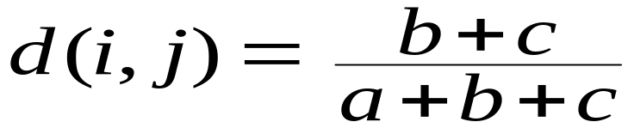
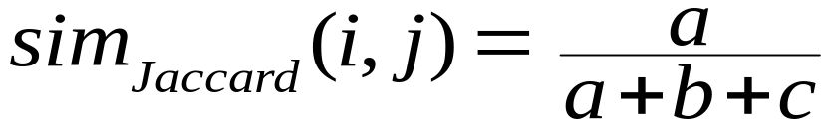
Binary Variables
Object j
A contingency table for binary data
Distance measure for symmetric binary variables:
Distance measure for asymmetric binary variables:
Jaccard coefficient (similarity measure for asymmetric binary variables):
Object i

Slide 13


Dissimilarity between Binary Variables
Example
  gender is a symmetric attribute
  the remaining attributes are asymmetric binary
  let the values Y and P be set to 1, and the value N be set to 0

Slide 14

Nominal Variables
A generalization of the binary variable in that it can take more than 2 states, e.g., red, yellow, blue, green
Method 1: Simple matching
  m: # of matches, p: total # of variables
Method 2: use a large number of binary variables
  creating a new binary variable for each of the M nominal states

Slide 15


Ordinal Variables
An ordinal variable can be discrete or continuous
Order is important, e.g., rank
Can be treated like interval-scaled
  replace x_{if} by their rank
  map the range of each variable onto [0, 1] by replacing i-th object in the f-th variable by
  compute the dissimilarity using methods for interval-scaled variables

Slide 16
Ratio-Scaled Variables
Ratio-scaled variable: a positive measurement on a nonlinear scale, approximately at exponential scale, such as Ae^{Bt} or Ae^{-Bt}
Methods:
  treat them like interval-scaled variables—not a good choice! (why?—the scale can be distorted)
  apply logarithmic transformation
y_{if} = log(x_{if})
  treat them as continuous ordinal data treat their rank as interval-scaled

Slide 17


Variables of Mixed Types
A database may contain all the six types of variables
  symmetric binary, asymmetric binary, nominal, ordinal, interval and ratio
One may use a weighted formula to combine their effects
  f is binary or nominal:
    d_{ij}^{(f)} = 0 if x_{if} = x_{jf} , or d_{ij}^{(f)} = 1 otherwise
  f is interval-based: use the normalized distance
  f is ordinal or ratio-scaled
    compute ranks r_{if} and
    and treat z_{if} as interval-scaled

Slide 18


Vector Objects
Vector objects: keywords in documents, gene features in micro-arrays, etc.
Broad applications: information retrieval, biologic taxonomy, etc.
Cosine measure
A variant: Tanimoto coefficient

Slide 19
Major Clustering Approaches (I)
Partitioning approach:
  Construct various partitions and then evaluate them by some criterion, e.g., minimizing the sum of square errors
  Typical methods: k-means, k-medoids, CLARANS
Hierarchical approach:
  Create a hierarchical decomposition of the set of data (or objects) using some criterion
  Typical methods: Diana, Agnes, BIRCH, ROCK, CAMELEON
Density-based approach:
  Based on connectivity and density functions
  Typical methods: DBSACN, OPTICS, DenClue

Slide 20
Major Clustering Approaches (II)
Grid-based approach:
  based on a multiple-level granularity structure
  Typical methods: STING, WaveCluster, CLIQUE
Model-based:
  A model is hypothesized for each of the clusters and tries to find the best fit of that model to each other
  Typical methods: EM, SOM, COBWEB
Frequent pattern-based:
  Based on the analysis of frequent patterns
  Typical methods: pCluster
User-guided or constraint-based:
  Clustering by considering user-specified or application-specific constraints
  Typical methods: COD (obstacles), constrained clustering

Slide 21
Typical Alternatives to Calculate the Distance between Clusters
Single link: smallest distance between an element in one cluster and an element in the other, i.e., dis(K_{i}, K_{j}) = min(t_{ip}, t_{jq})
Complete link: largest distance between an element in one cluster and an element in the other, i.e., dis(K_{i}, K_{j}) = max(t_{ip}, t_{jq})
Average: avg distance between an element in one cluster and an element in the other, i.e., dis(K_{i}, K_{j}) = avg(t_{ip}, t_{jq})
Centroid: distance between the centroids of two clusters, i.e., dis(K_{i}, K_{j}) = dis(C_{i}, C_{j})
Medoid: distance between the medoids of two clusters, i.e., dis(K_{i}, K_{j}) = dis(M_{i}, M_{j})
  Medoid: one chosen, centrally located object in the cluster

Slide 22
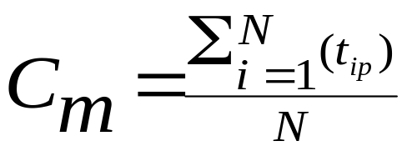
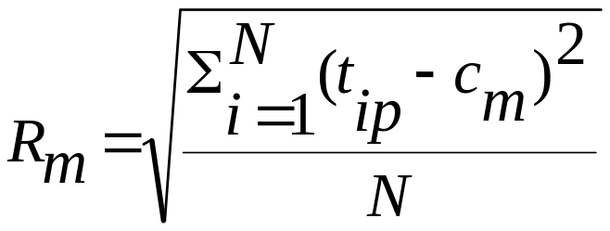
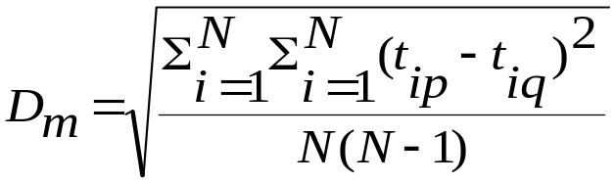
Centroid, Radius and Diameter of a Cluster (for numerical data sets)
Centroid: the “middle” of a cluster
Radius: square root of average distance from any point of the cluster to its centroid
Diameter: square root of average mean squared distance between all pairs of points in the cluster

Slide 23
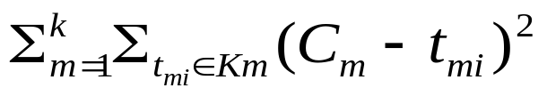
Partitioning Algorithms: Basic Concept
Partitioning method: Construct a partition of a database D of n objects into a set of k clusters, s.t., min sum of squared distance
Given a k, find a partition of k clusters that optimizes the chosen partitioning criterion
  Global optimal: exhaustively enumerate all partitions
  Heuristic methods: k-means and k-medoids algorithms
  k-means (MacQueen’67): Each cluster is represented by the center of the cluster
  k-medoids or PAM (Partition around medoids) (Kaufman & Rousseeuw’87): Each cluster is represented by one of the objects in the cluster

Slide 24
The K-Means Clustering Method
Given k, the k-means algorithm is implemented in four steps:
  Partition objects into k nonempty subsets
  Compute seed points as the centroids of the clusters of the current partition (the centroid is the center, i.e., mean point, of the cluster)
  Assign each object to the cluster with the nearest seed point
  Go back to Step 2, stop when no more new assignment

Slide 25



The K-Means Clustering Method
Example
10
10
9
9
8
8
7
7
6
6
5
5
4
Assign each objects to most similar center
Update the cluster means
4
3
3
2
2
1
1
0
0
0
1
2
3
4
5
6
7
8
9
10
0
1
2
3
4
5
6
7
8
9
10
reassign
reassign
K=2
Arbitrarily choose K object as initial cluster center
Update the cluster means

Slide 26
Comments on the K-Means Method
Strength: Relatively efficient: O(tkn), where n is # objects, k is # clusters, and t is # iterations. Normally, k, t << n.
    Comparing: PAM: O(k(n-k)² ), CLARA: O(ks² + k(n-k))
Comment: Often terminates at a local optimum. The global optimum may be found using techniques such as: deterministic annealing and genetic algorithms
Weakness
  Applicable only when mean is defined, then what about categorical data?
  Need to specify k, the number of clusters, in advance
  Unable to handle noisy data and outliers
  Not suitable to discover clusters with non-convex shapes

Slide 27
Variations of the K-Means Method
A few variants of the k-means which differ in
  Selection of the initial k means
  Dissimilarity calculations
  Strategies to calculate cluster means
Handling categorical data: k-modes (Huang’98)
  Replacing means of clusters with modes
  Using new dissimilarity measures to deal with categorical objects
  Using a frequency-based method to update modes of clusters
  A mixture of categorical and numerical data: k-prototype method

Slide 28
What Is the Problem of the K-Means Method?
The k-means algorithm is sensitive to outliers !
  Since an object with an extremely large value may substantially distort the distribution of the data.
K-Medoids: Instead of taking the mean value of the object in a cluster as a reference point, medoids can be used, which is the most centrally located object in a cluster.
10
10
9
9
8
8
7
7
6
6
5
5
4
4
3
3
2
2
1
1
0
0
1
2
3
4
5
6
7
8
9
10
0
0
1
2
3
4
5
6
7
8
9
10

Slide 29
The K-Medoids Clustering Method
Find representative objects, called medoids, in clusters
PAM (Partitioning Around Medoids, 1987)
  starts from an initial set of medoids and iteratively replaces one of the medoids by one of the non-medoids if it improves the total distance of the resulting clustering
  PAM works effectively for small data sets, but does not scale well for large data sets
CLARA (Kaufmann & Rousseeuw, 1990)
CLARANS (Ng & Han, 1994): Randomized sampling
Focusing + spatial data structure (Ester et al., 1995)

Slide 30

A Typical K-Medoids Algorithm (PAM)
Total Cost = 20
10
9
8
Arbitrary choose k object as initial medoids
Assign each remaining object to nearest medoids
7
6
5
4
3
2
1
0
0
1
2
3
4
5
6
7
8
9
10
K=2
Randomly select a nonmedoid object,O_{ramdom}
Total Cost = 26
Do loop
Until no change
10
10
9
Compute total cost of swapping
9
Swapping O and O_{ramdom}
If quality is improved.
8
8
7
7
6
6
5
5
4
4
3
3
2
2
1
1
0
0
1
2
3
4
5
6
7
8
9
10
0
0
1
2
3
4
5
6
7
8
9
10

Slide 31
PAM (Partitioning Around Medoids) (1987)
PAM (Kaufman and Rousseeuw, 1987), built in Splus
Use real object to represent the cluster
  Select k representative objects arbitrarily
  For each pair of non-selected object h and selected object i, calculate the total swapping cost TC_{ih}
  For each pair of i and h,
    If TC_{ih} < 0, i is replaced by h
    Then assign each non-selected object to the most similar representative object
  repeat steps 2-3 until there is no change

Slide 32
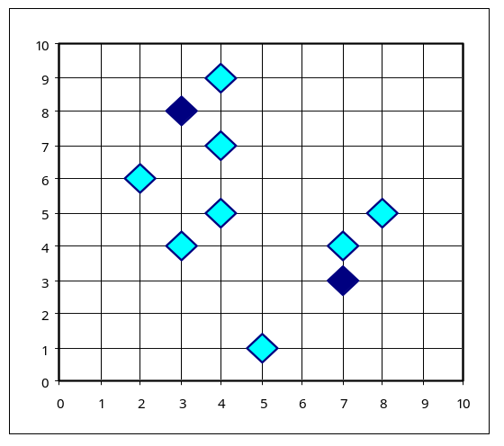
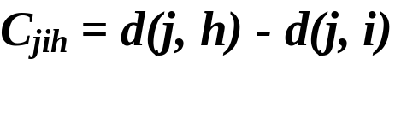

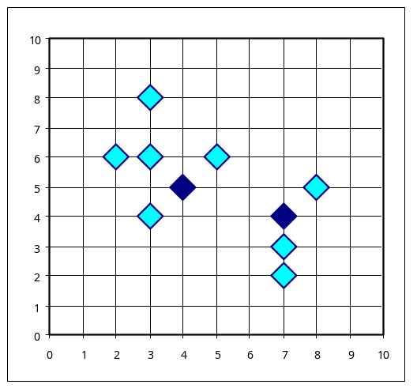
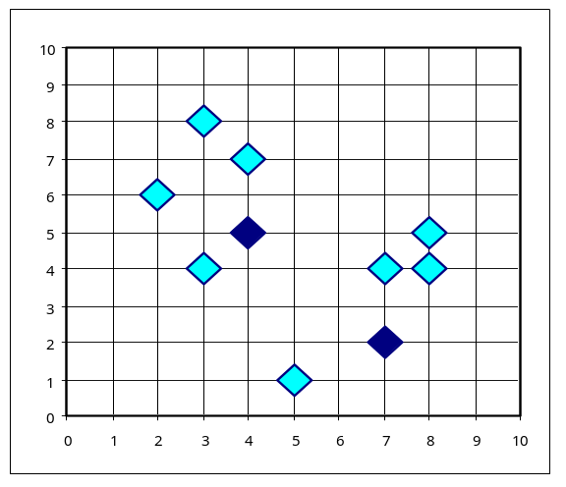


PAM Clustering: Total swapping cost TC_{ih}=∑_{j}C_{jih}
t
j
t
j
i
h
h
i
h
j
i
i
t
h
j
t

Slide 33
What Is the Problem with PAM?
Pam is more robust than k-means in the presence of noise and outliers because a medoid is less influenced by outliers or other extreme values than a mean
Pam works efficiently for small data sets but does not scale well for large data sets.
  O(k(n-k)² ) for each iteration
where n is # of data,k is # of clusters
Sampling based method,
CLARA(Clustering LARge Applications)

Slide 34
CLARA (Clustering Large Applications) (1990)
CLARA (Kaufmann and Rousseeuw in 1990)
  Built in statistical analysis packages, such as S+
It draws multiple samples of the data set, applies PAM on each sample, and gives the best clustering as the output
Strength: deals with larger data sets than PAM
Weakness:
  Efficiency depends on the sample size
  A good clustering based on samples will not necessarily represent a good clustering of the whole data set if the sample is biased

Slide 35
CLARANS (“Randomized” CLARA) (1994)
CLARANS (A Clustering Algorithm based on Randomized Search) (Ng and Han’94)
CLARANS draws sample of neighbors dynamically
The clustering process can be presented as searching a graph where every node is a potential solution, that is, a set of k medoids
If the local optimum is found, CLARANS starts with new randomly selected node in search for a new local optimum
It is more efficient and scalable than both PAM and CLARA
Focusing techniques and spatial access structures may further improve its performance (Ester et al.’95)

Slide 36
Hierarchical Clustering
Use distance matrix as clustering criteria. This method does not require the number of clusters k as an input, but needs a termination condition
Step 0
Step 1
Step 2
Step 3
Step 4
agglomerative
(AGNES)
a
a b
b
a b c d e
c
c d e
d
d e
e
divisive
(DIANA)
Step 4
Step 3
Step 2
Step 1
Step 0

Slide 37

AGNES (Agglomerative Nesting)
Introduced in Kaufmann and Rousseeuw (1990)
Implemented in statistical analysis packages, e.g., Splus
Use the Single-Link method and the dissimilarity matrix.
Merge nodes that have the least dissimilarity
Go on in a non-descending fashion
Eventually all nodes belong to the same cluster

Slide 38
Dendrogram: Shows How the Clusters are Merged
  Decompose data objects into a several levels of nested partitioning (tree of clusters), called a dendrogram.
  A clustering of the data objects is obtained by cutting the dendrogram at the desired level, then each connected component forms a cluster.

Slide 39
DIANA (Divisive Analysis)
Introduced in Kaufmann and Rousseeuw (1990)
Implemented in statistical analysis packages, e.g., Splus
Inverse order of AGNES
Eventually each node forms a cluster on its own

Slide 40
Recent Hierarchical Clustering Methods
Major weakness of agglomerative clustering methods
  do not scale well: time complexity of at least O(n²), where n is the number of total objects
  can never undo what was done previously
Integration of hierarchical with distance-based clustering
  BIRCH (1996): uses CF-tree and incrementally adjusts the quality of sub-clusters
  ROCK (1999): clustering categorical data by neighbor and link analysis
  CHAMELEON (1999): hierarchical clustering using dynamic modeling

Slide 41
Clustering High-Dimensional Data
Clustering high-dimensional data
  Many applications: text documents, DNA micro-array data
  Major challenges:
    Many irrelevant dimensions may mask clusters
    Distance measure becomes meaningless—due to equi-distance
    Clusters may exist only in some subspaces
Methods
  Feature transformation: only effective if most dimensions are relevant
    PCA & SVD useful only when features are highly correlated/redundant
  Feature selection: wrapper or filter approaches
    useful to find a subspace where the data have nice clusters
  Subspace-clustering: find clusters in all the possible subspaces
    CLIQUE, ProClus, and frequent pattern-based clustering

Slide 42
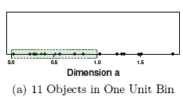
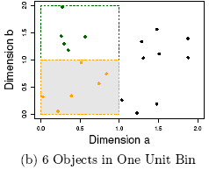
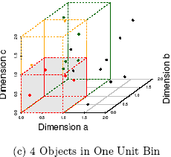
The Curse of Dimensionality
(graphs adapted from Parsons et al. KDD Explorations 2004)
Data in only one dimension is relatively packed
Adding a dimension “stretch” the points across that dimension, making them further apart
Adding more dimensions will make the points further apart—high dimensional data is extremely sparse
Distance measure becomes meaningless—due to equi-distance

Slide 43
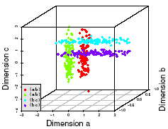
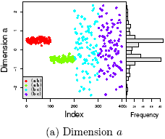
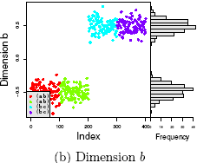
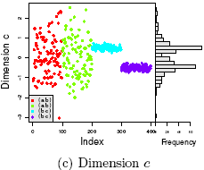
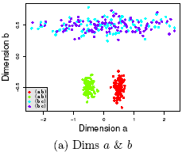
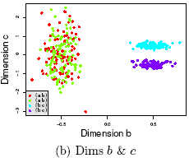
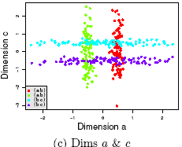
Why Subspace Clustering?
(adapted from Parsons et al. SIGKDD Explorations 2004)
Clusters may exist only in some subspaces
Subspace-clustering: find clusters in all the subspaces

Slide 44
What Is Outlier Discovery?
What are outliers?
  The set of objects are considerably dissimilar from the remainder of the data
  Example: Sports: Michael Jordon, Wayne Gretzky, ...
Problem: Define and find outliers in large data sets
Applications:
  Credit card fraud detection
  Telecom fraud detection
  Customer segmentation
  Medical analysis

Slide 45

Outlier Discovery: Statistical Approaches
Assume a model underlying distribution that generates data set (e.g. normal distribution)
Use discordancy tests depending on
  data distribution
  distribution parameter (e.g., mean, variance)
  number of expected outliers
Drawbacks
  most tests are for single attribute
  In many cases, data distribution may not be known

Slide 46
Outlier Discovery: Distance-Based Approach
Introduced to counter the main limitations imposed by statistical methods
  We need multi-dimensional analysis without knowing data distribution
Distance-based outlier: A DB(p, D)-outlier is an object O in a dataset T such that at least a fraction p of the objects in T lies at a distance greater than D from O
Algorithms for mining distance-based outliers
  Index-based algorithm
  Nested-loop algorithm
  Cell-based algorithm

Slide 47
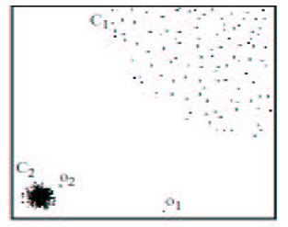
Density-Based Local Outlier Detection
Distance-based outlier detection is based on global distance distribution
It encounters difficulties to identify outliers if data is not uniformly distributed
Ex. C₁ contains 400 loosely distributed points, C₂ has 100 tightly condensed points, 2 outlier points o₁, o₂
Distance-based method cannot identify o₂ as an outlier
Need the concept of local outlier
Local outlier factor (LOF)
  Assume outlier is not crisp
  Each point has a LOF

Slide 48
Summary
Cluster analysis groups objects based on their similarity and has wide applications
Measure of similarity can be computed for various types of data
Clustering algorithms can be categorized into partitioning methods, hierarchical methods, density-based methods, grid-based methods, and model-based methods
Outlier detection and analysis are very useful for fraud detection, etc. and can be performed by statistical, distance-based or deviation-based approaches
There are still lots of research issues on cluster analysis

Slide 49
References (1)
R. Agrawal, J. Gehrke, D. Gunopulos, and P. Raghavan. Automatic subspace clustering of high dimensional data for data mining applications. SIGMOD'98
M. R. Anderberg. Cluster Analysis for Applications. Academic Press, 1973.
M. Ankerst, M. Breunig, H.-P. Kriegel, and J. Sander. Optics: Ordering points to identify the clustering structure, SIGMOD’99.
P. Arabie, L. J. Hubert, and G. De Soete. Clustering and Classification. World Scientific, 1996
Beil F., Ester M., Xu X.: "Frequent Term-Based Text Clustering", KDD'02
M. M. Breunig, H.-P. Kriegel, R. Ng, J. Sander. LOF: Identifying Density-Based Local Outliers. SIGMOD 2000.
M. Ester, H.-P. Kriegel, J. Sander, and X. Xu. A density-based algorithm for discovering clusters in large spatial databases. KDD'96.
M. Ester, H.-P. Kriegel, and X. Xu. Knowledge discovery in large spatial databases: Focusing techniques for efficient class identification. SSD'95.
D. Fisher. Knowledge acquisition via incremental conceptual clustering. Machine Learning, 2:139-172, 1987.
D. Gibson, J. Kleinberg, and P. Raghavan. Clustering categorical data: An approach based on dynamic systems. VLDB’98.

Slide 50
References (2)
V. Ganti, J. Gehrke, R. Ramakrishan. CACTUS Clustering Categorical Data Using Summaries. KDD'99.
D. Gibson, J. Kleinberg, and P. Raghavan. Clustering categorical data: An approach based on dynamic systems. In Proc. VLDB’98.
S. Guha, R. Rastogi, and K. Shim. Cure: An efficient clustering algorithm for large databases. SIGMOD'98.
S. Guha, R. Rastogi, and K. Shim. ROCK: A robust clustering algorithm for categorical attributes. In ICDE'99, pp. 512-521, Sydney, Australia, March 1999.
A. Hinneburg, D.l A. Keim: An Efficient Approach to Clustering in Large Multimedia Databases with Noise. KDD’98.
A. K. Jain and R. C. Dubes. Algorithms for Clustering Data. Printice Hall, 1988.
G. Karypis, E.-H. Han, and V. Kumar. CHAMELEON: A Hierarchical Clustering Algorithm Using Dynamic Modeling. COMPUTER, 32(8): 68-75, 1999.
L. Kaufman and P. J. Rousseeuw. Finding Groups in Data: an Introduction to Cluster Analysis. John Wiley & Sons, 1990.
E. Knorr and R. Ng. Algorithms for mining distance-based outliers in large datasets. VLDB’98.
G. J. McLachlan and K.E. Bkasford. Mixture Models: Inference and Applications to Clustering. John Wiley and Sons, 1988.
P. Michaud. Clustering techniques. Future Generation Computer systems, 13, 1997.
R. Ng and J. Han. Efficient and effective clustering method for spatial data mining. VLDB'94.

Slide 51
References (3)
L. Parsons, E. Haque and H. Liu, Subspace Clustering for High Dimensional Data: A Review , SIGKDD Explorations, 6(1), June 2004
E. Schikuta. Grid clustering: An efficient hierarchical clustering method for very large data sets. Proc. 1996 Int. Conf. on Pattern Recognition,.
G. Sheikholeslami, S. Chatterjee, and A. Zhang. WaveCluster: A multi-resolution clustering approach for very large spatial databases. VLDB’98.
A. K. H. Tung, J. Han, L. V. S. Lakshmanan, and R. T. Ng. Constraint-Based Clustering in Large Databases, ICDT'01.
A. K. H. Tung, J. Hou, and J. Han. Spatial Clustering in the Presence of Obstacles , ICDE'01
H. Wang, W. Wang, J. Yang, and P.S. Yu. Clustering by pattern similarity in large data sets, SIGMOD’ 02.
W. Wang, Yang, R. Muntz, STING: A Statistical Information grid Approach to Spatial Data Mining, VLDB’97.
T. Zhang, R. Ramakrishnan, and M. Livny. BIRCH : an efficient data clustering method for very large databases. SIGMOD'96.

